Slide 1
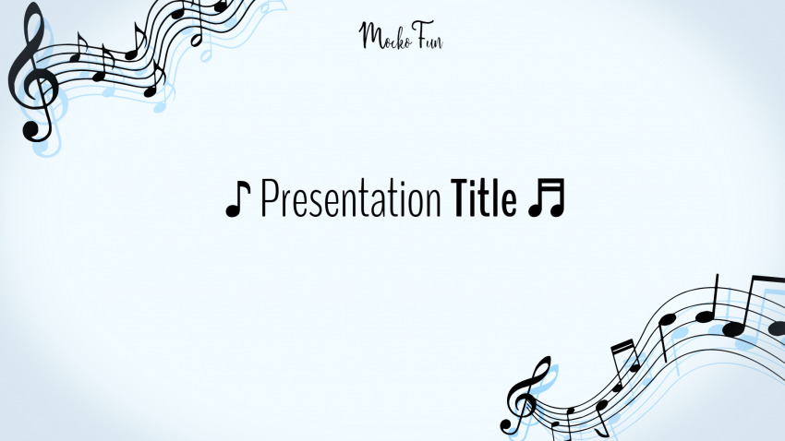
CHATBOT BASED SONG RECOMMENDATION SYSTEM

Slide 2
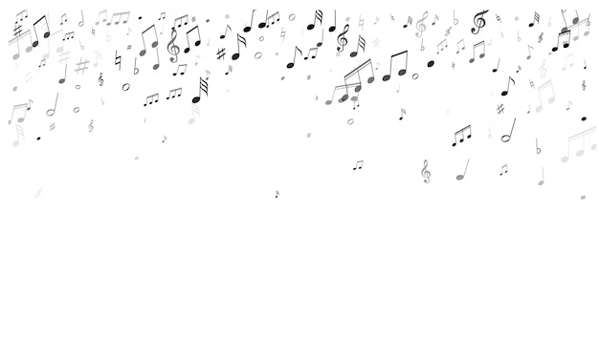
Group ID: 3
Project Title: CHATBOT BASED SONG RECOMMENDATION SYSTEM BASED ON MOOD
Guide : Prof. Suresh Kapre
Group Members:
Enrollment Number | Roll No. | Name of student | Email Id | Contact Number
MITU22BTCS0615 | 2223475 | Raashi Lokhande | raashilokhande@gmail.com | 9284839431
MITU22BTCS0545 | 2223472 | Prachi Kunjir | kunjirprachi234@gmail.com | 9028227369
MITU22BTCS0755 | 2223486 | Sayali Ingole | imsayali2903@gmail.com | 9834851305
MITU22BTCS0880 | 2223491 | Sushaan Satyam | sushaansatyam0307@gmail.com | 9955352992

Slide 3

Table Of Contents:
Introduction to the Chatbot based song recommendation system.
Working of the Chatbot based song recommendation system.
Problem statement for chatbot based song recommendation system.
Objectives
Block Diagram
Proposed architecture
Software and Hardware
Advantages and Disadvantages
Future Scope
Results
Conclusion

Slide 4

INTRODUCTION
A chatbot based on song recommendation is a conversational AI that can recommend songs to users based on their mood.
It works by asking the user a few questions to get to know their music taste, and then uses this
information to generate a personalized list of recommendations.
Chatbot song recommenders can be used in a variety of ways, such as:
Discover new music.
Mood-based recommendations.
Find music like your favorites

Slide 5
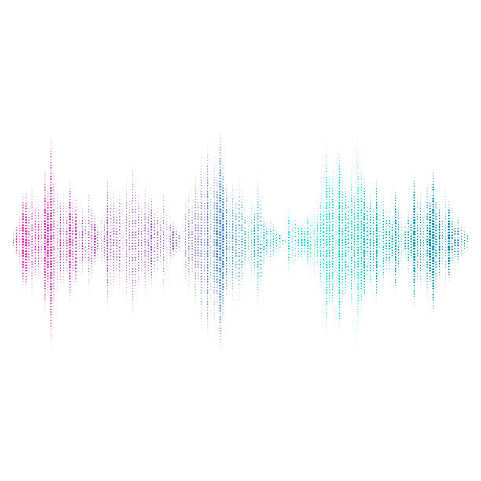
Working of Chatbot based song recommendation system
User starts the conversation. The user can start the conversation with the chatbot by typing a message
Chatbot asks questions. The chatbot will ask the user questions about their current mood.
Chatbot analyzes the user's responses. The chatbot will analyze the user's responses and identify their and current mood.
Chatbot generates song recommendations. The chatbot will generate a list of song recommendations based on the user's preferences and current mood.
Chatbot presents the song recommendations to the user. The chatbot can present the song recommendations to the user in a variety of ways, such as:
Sending a list of song links to the user's chat window.
Playing the song recommendations for the user.
Allowing the user to browse and select a song recommendation to play

Slide 6
Problem Statement:
Music listener is a person who listens to music as per his/her mood ,Who needs Logs into the personalized song recommendation system, who can receive a list of personalized song recommendations according to their mood and relevant factors because they have Limited Music Discovery, Inaccurate Mood Detection and Lack of Personalization .
Solution:
The chatbot may ask users questions about their music tastes and then provide recommendations based on their responses. This can assist users in learning more about their own musical likes and discovering new songs that they may not have discovered otherwise.

Slide 7

Objectives
To develop a system that can generate song recommendations that are more personalized than traditional music recommendation systems.
To develop a system that can provide users with an interactive and engaging song recommendation experience.
To develop a system that is easy to use by the user.
To evaluate the performance of the system and make improvements over time.

Slide 8
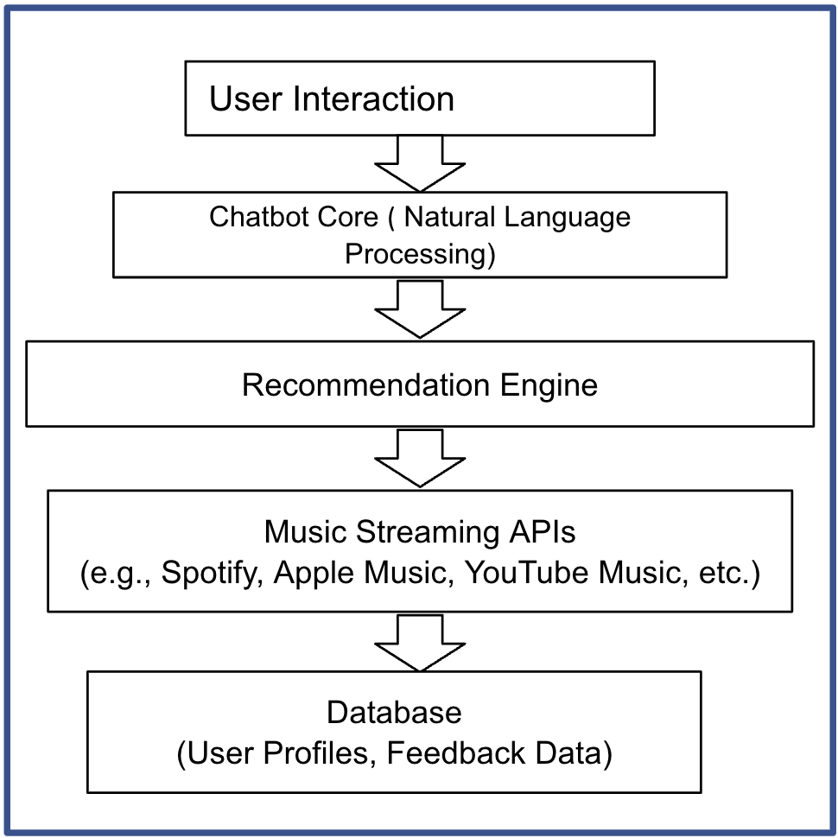
BLOCK
DIAGRAM

Slide 9
Proposed Architecture
Chatbot interface: The chatbot interface is the interface that users interact with to ask the chatbot questions about their musical preferences.
Song recommendation algorithm: The song recommendation algorithm is responsible for generating a list of song recommendations for the user based on their preferences
Recommendation engine: The recommendation engine uses the song recommendation algorithm.

Slide 10

Software Requirements
Operating System
a) Windows
Coding Language
a) Python
b) HTML
c) CSS
IDE
>>THONY
>>Pythonanywhere
MODULES
>>flask
>>pytz

Slide 11
Advantages
Convenience: Chatbots are always available, so users can get song recommendations whenever they need them.
Personalization: Chatbots can generate personalized recommendations based on the user's individual music taste and preferences.
Discovery: Chatbots can help users discover new music that they may not have found on their own.
Variety: Chatbots can recommend songs from a wide variety of genres and eras.

Slide 12
Disadvantages
Accuracy of recommendations: Chatbots need to be able to accurately recommend songs to users based on their music taste and preferences. This can be challenging, as users' music taste can be complex and multifaceted.
User experience: Chatbots need to be easy to use and navigate. The conversational flow should be natural and engaging, and the chatbot should be able to understand and respond to a wide range of natural language queries.

Slide 13
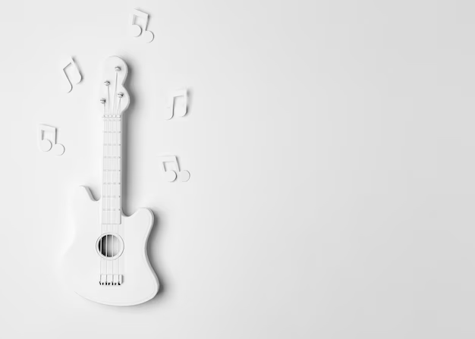
Future Scope
More accurate and personalized recommendations: Chatbots will be able to generate more accurate and personalized recommendations as they learn more about the user's music taste and preferences over time.
Better music discovery: Chatbots will be able to help users discover new music that they are likely to enjoy, even if it is from a genre or era that they are not familiar with.
More natural and engaging user experience: Chatbots will become more natural and engaging to interact with, making it easier and more enjoyable for users to discover new music.
If Integration with other AI technologies: Chatbots will be integrated with other AI technologies, such as mood detection and music generation, to create even more personalized and engaging music experiences.

Slide 14
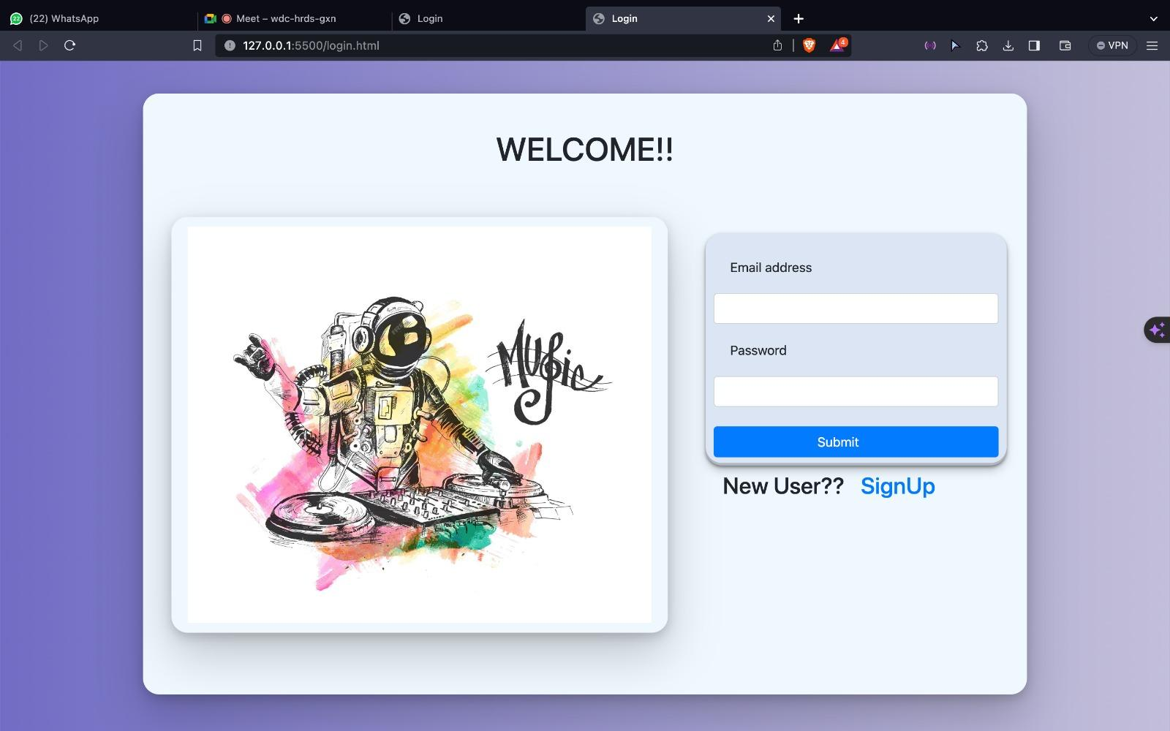
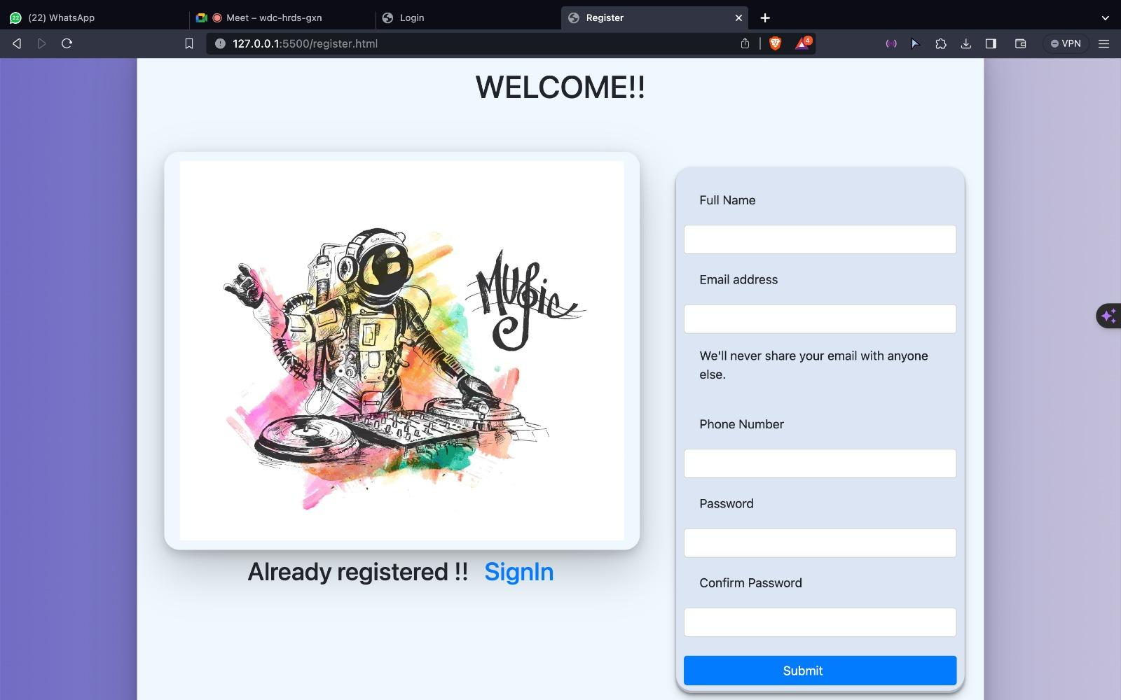
Results

Slide 15
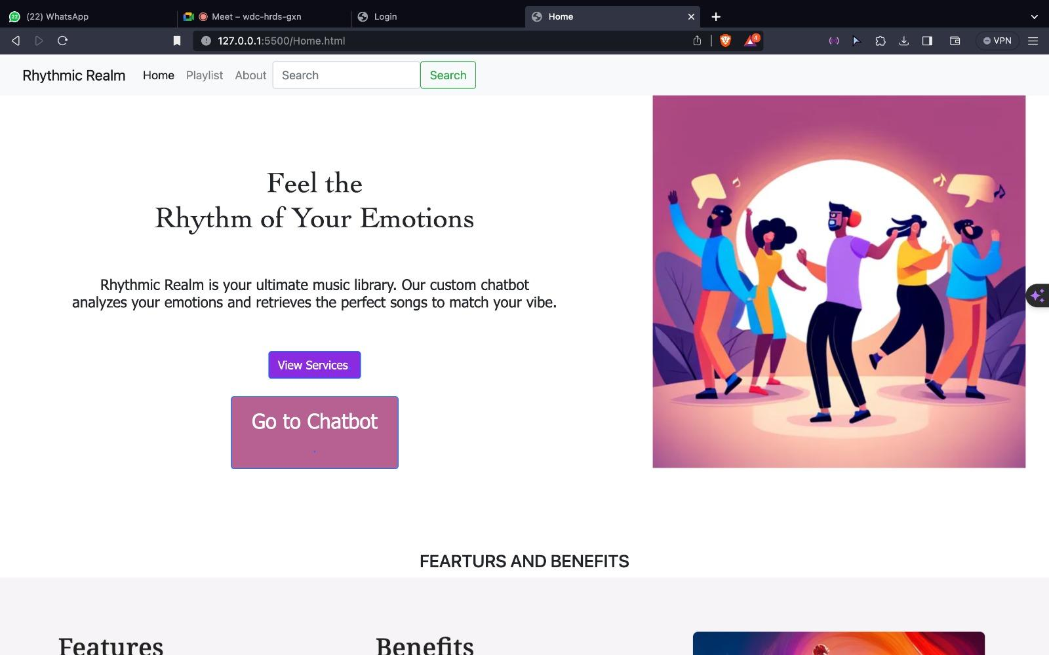
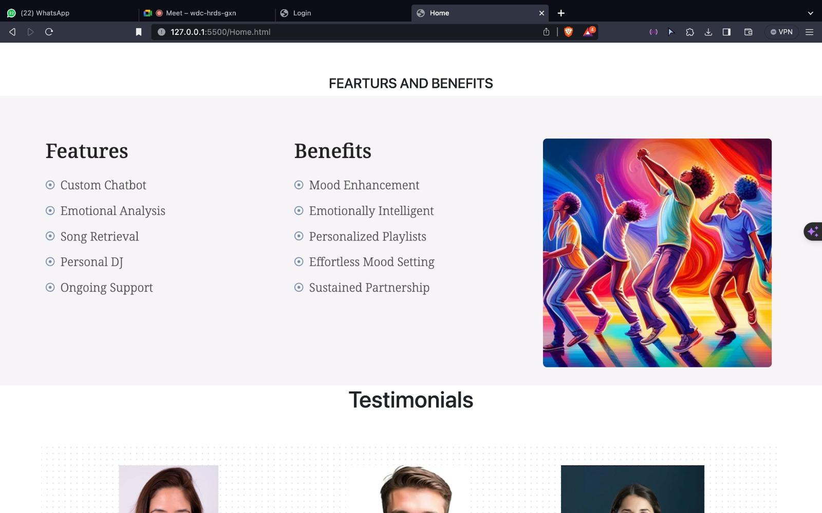
Results

Slide 16
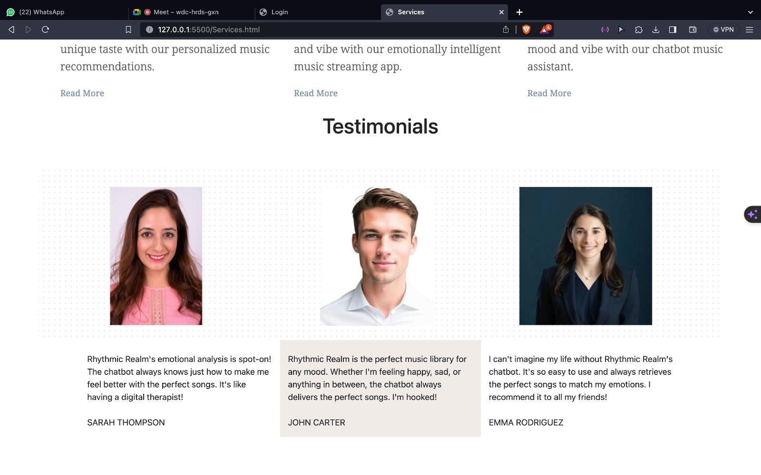
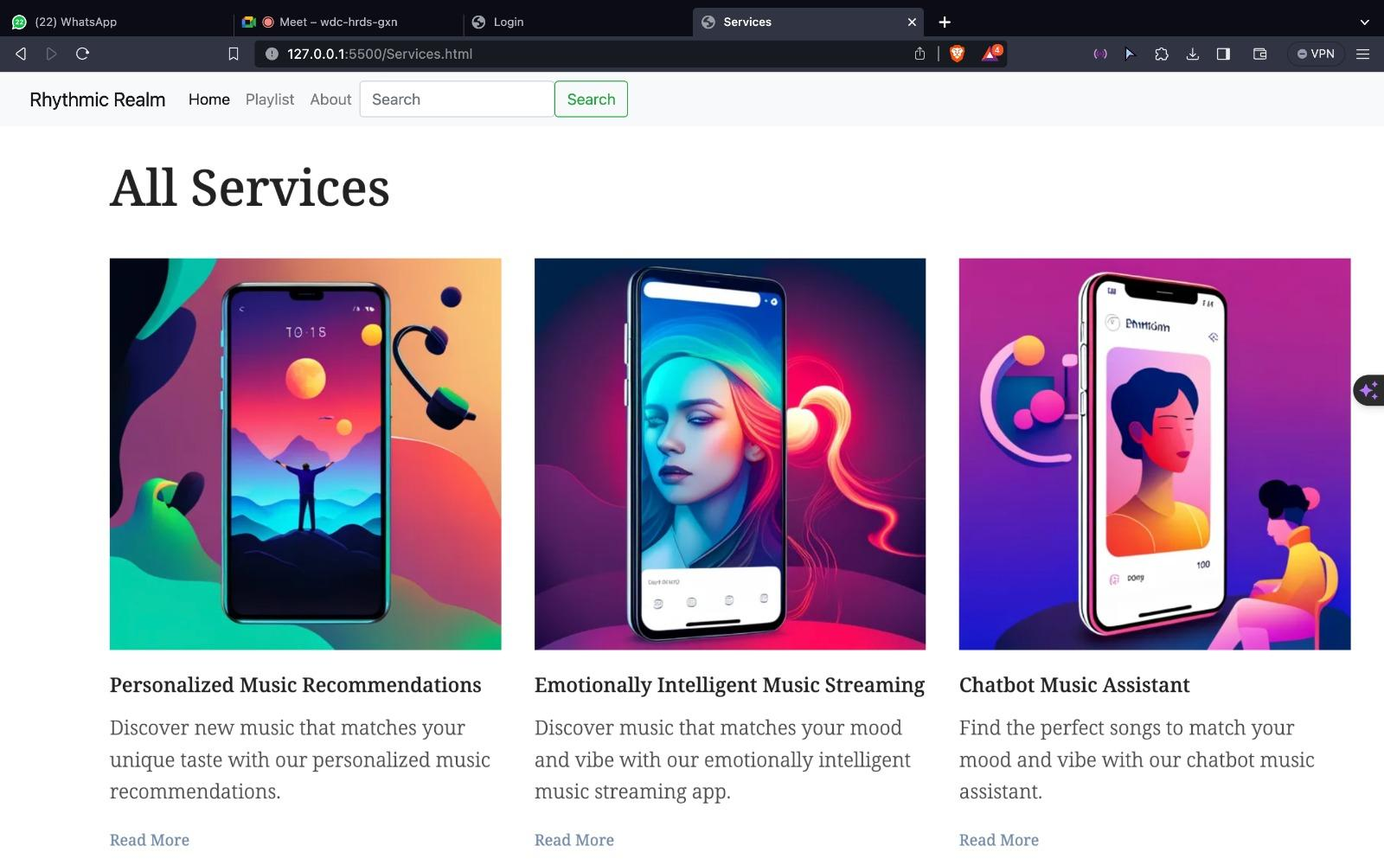
Results

Slide 17
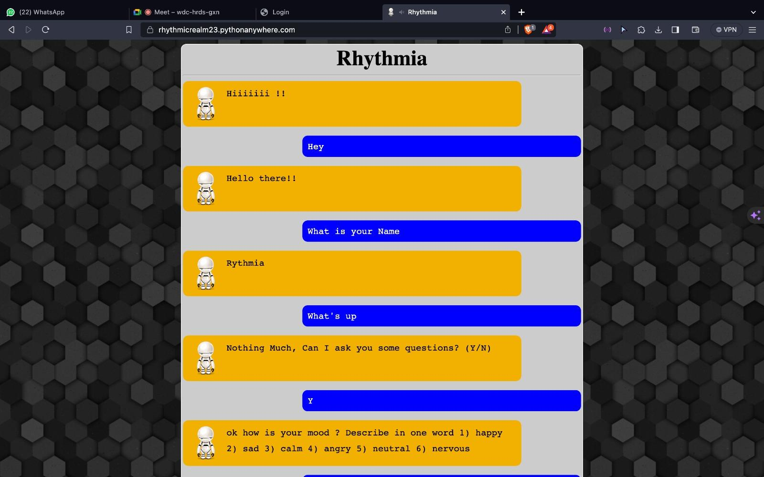
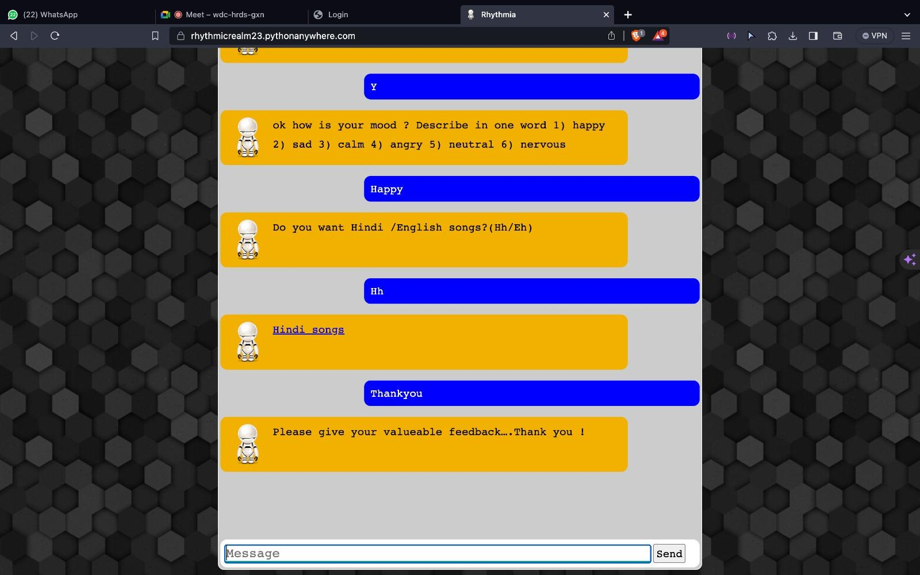
Results

Slide 18
Conclusion
Chatbot-based song recommendation systems have the potential to revolutionize the way that people listen to music. By providing users with personalized and interactive song recommendations, chatbot-based systems can help users to discover new music, save time, and have a more enjoyable listening experience.
Chatbot-based song recommendation systems are still under development, but they have already shown great promise. In the future, we can expect to see these systems become more sophisticated and widely adopted.

Slide 19


